Slide 1
Rule Set 3 Filtering Scheme and Out of Frame Mutation Rate

Slide 2
Filtering

Slide 3
For the Flow Cytometry (FC) and Resistence (RES) data we will filter guides in 2 steps:
Filter genes that have low replicate correlation and/or high variability for Log-Fold Change. If there are multiple conditions per gene, then pick the most well correlated.
Filter guides that have high replicate variability for Log-Fold Change (3 standard deviations from the mean), or have no variability at all.

Slide 4
Human Flow Cytometry Data

Slide 5
Gene Filtering
Cell
Gene
Avg. Rep. Correlation
Avg. Variance
Avg.Avg.LFC
Guides
Avg.LFC Variance
Dip.Test.P-Val
Remove
MOLM-13
CD15
0.9662890
0.0240898
0.4856672
384
0.6922808
0.0005
FALSE
TF-1
CD13
0.9570524
0.0646212
0.5501278
480
1.4466709
0.0005
FALSE
MOLM-13
CD33
0.9429190
0.0586406
1.8360495
192
0.9571894
0.9545
FALSE
NB4
CD13
0.9586049
0.0566933
0.7731802
480
1.2946018
0.6725
TRUE
NB4
CD33
0.9098274
0.1258232
1.5708943
192
1.2518799
0.9410
TRUE

Slide 6
Guide Filtering
Guides targetting CD13 are more variable in TF-1 cells, so we will get better seperation between good and bad guides
Lower technical replicate correlation of CD44 in NB4 is lower
Note: Replicates for FC data are technical, not experimental
Filter out any guides with high (or no) variability across replicates
Guides are highly variability if they have a variance greater than 3 standard deviations from the mean variability
Removed 10 guides*

Slide 7
Mouse Flow Cytometry Data

Slide 8
Gene Filtering
Gene
Avg.Rep.Correlation
Avg.Variance
Avg.Avg.LFC
Guides
Avg.LFC Variance
Dip.Test.P-Val
Remove
H2-K
0.8211892
1.2035568
2.1761582
235
5.6704374
0.0015
FALSE
CD45
0.8140521
1.2587999
1.1741811
584
5.6286802
0.0000
FALSE
Cd5
0.7660277
2.0192704
1.0007152
423
6.9193161
0.0005
FALSE
Cd43
0.7573723
1.5938866
0.5684481
637
5.2267523
0.0000
FALSE
Thy1
0.7461000
2.0896311
0.7131360
363
6.4481478
0.0000
FALSE
Cd28
0.5857841
6.8655039
-1.0380493
438
10.8284672
0.4360
FALSE
Cd53
0.5657920
0.1380933
0.4814790
238
0.2021161
0.5660
TRUE
Cd3e
0.4469605
2.7745785
0.2972853
260
2.6989556
0.9590
TRUE
Cd2
0.1999299
0.2130592
0.1159250
191
0.0885697
0.8170
TRUE
Cd53: low LFC variance
Cd2, Cd3e: low replicate correlation

Slide 9
Guide Filtering
Remove highly variable guides (variance of LFC’s 3 sd from mean)
Removed 64 guides

Slide 10
Human Resistence Data

Slide 11
Gene Filtering
Drug
Gene
Avg. Rep. Correlation
Avg. Variance
Avg.Avg.LFC
Guides
Avg.LFC Variance
Dip.Test.P-Val
Remove
6TG
HPRT1
0.9296532
0.5917359
3.6539692
64
7.5110608
0.9915945
FALSE
AZD
MED12
0.8758470
0.4875722
0.6236769
956
3.5307290
0.9935129
FALSE
AZD
TADA1
0.8184488
0.6957460
-0.6849490
111
3.1061818
0.0574928
FALSE
AZD
TADA2B
0.7575317
0.6708192
-0.1506191
201
2.1925174
0.9914553
FALSE
AZD
CCDC101
0.7042762
0.9569480
-0.2300276
160
2.4852626
0.9866788
FALSE
PLX
NF2
0.6519871
1.4997459
-0.0615335
226
3.1726561
0.8529861
FALSE
PLX
NF1
0.5680280
1.8320517
-0.9834906
745
2.8341151
0.0414965
FALSE
PLX
MED12
0.7805298
0.7922638
-0.5966506
956
2.9941566
0.8994090
TRUE
PLX
CUL3
0.4344678
2.9605273
-0.6183203
155
2.9995941
0.6150521
TRUE
6TG
PMS2
0.2618040
1.1758838
-4.1004333
262
0.6980747
0.9928136
TRUE
6TG
MSH2
0.2541437
1.8882252
-4.2050059
224
1.1143426
0.9912448
TRUE
6TG
MSH6
0.1981200
1.4471243
-4.2796887
432
0.7176871
0.9909761
TRUE
6TG
MLH1
0.1093879
1.3699372
-4.3180802
256
0.5058294
0.8154171
TRUE
PLX/MED12: lower replicate correlation than AZD/MED12
Low replicate correlation for other genes Note: Replicates are experimental for RES data

Slide 12
Guide Filtering
Remove highly variable guides (variance of LFC’s 3 sd from mean)
Removed 112 guides

Slide 13
Training Set

Slide 14
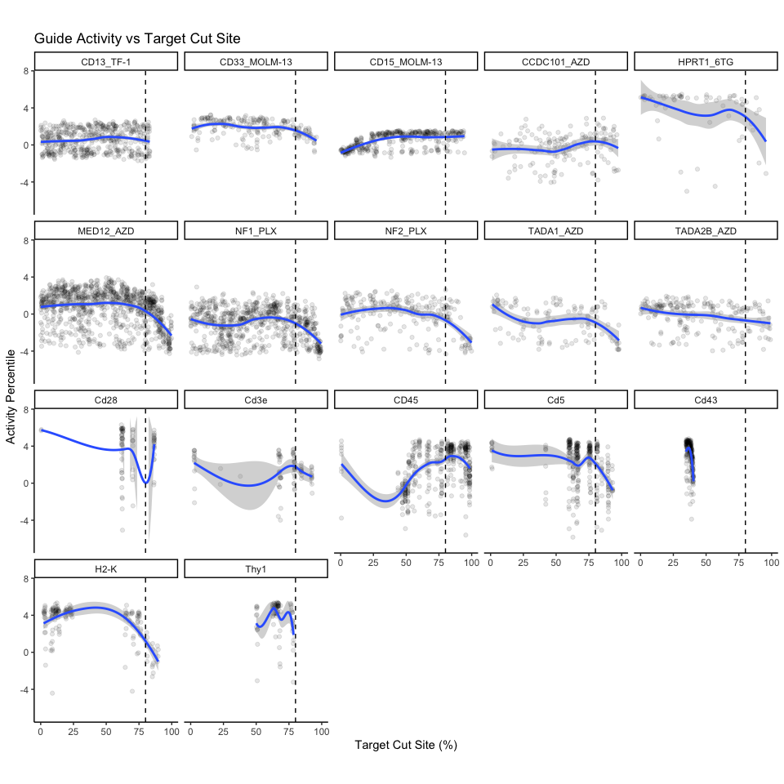
Target Cut Site

Slide 15
Test Filtering at 80, 90, 100 percent

Slide 16
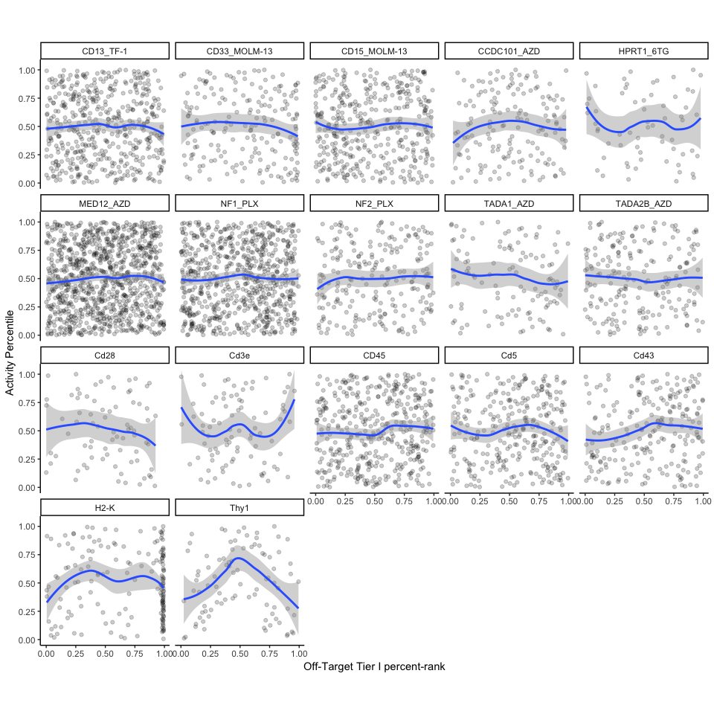
Off Target Effects

Slide 17
Will not filter by off-target effects

Slide 18
Training Set Summary

Slide 19
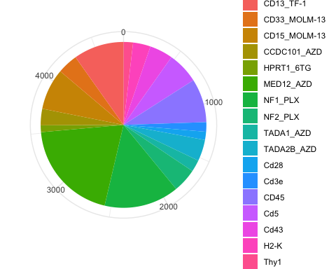

Slide 20
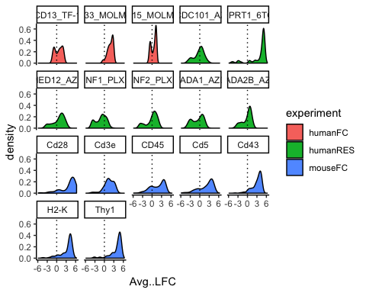

Slide 21
## [1] 169
## # A tibble: 13 x 2 ## Target n ## <fct> <int> ## 1 CCDC101 4 ## 2 CD28 4 ## 3 CD43 1 ## 4 CD45 22 ## 5 CD5 2 ## 6 CUL3 26 ## 7 H2-K 51 ## 8 HPRT1 1 ## 9 MED12 2 ## 10 NF1 48 ## 11 NF2 4 ## 12 TADA1 1 ## 13 THY1 4

Slide 22
Out Of Frame Mutation Rate

Slide 23
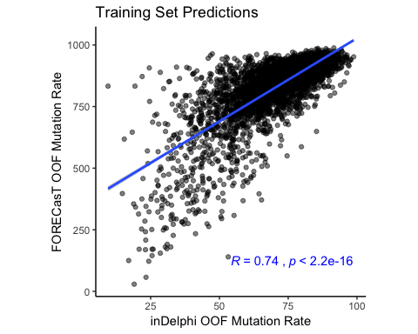
FORECasT and inDelphi Predict Similar OOF Mutation Rates

Slide 24
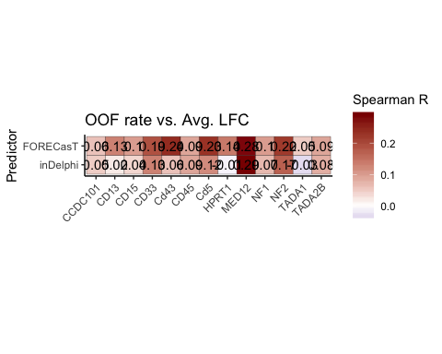
FORECasT Correlates Better With On Target Activity for 11 out of 13 Genes

Slide 25
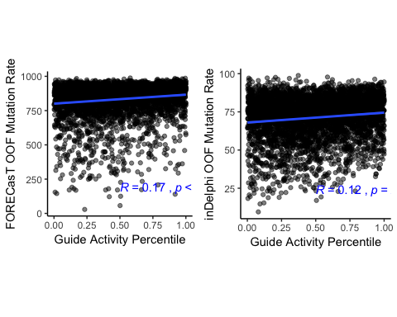
FORECasT Correlates Better When Considering All Guides

